Slide 1
INGLÉS I
Prof. Nidia S. Redonder
UTN - FRSF

Slide 2
TEXTO TÉCNICO
CARACTERÍSTICAS
Frase Nominal o sustantiva
Voz Pasiva
Formas –ING / -ED
Infinitivo

Slide 3
EL INFINITIVO
Forma verbal NO CONJUGADA
Se traduce con la terminación: -ar, -er, -ir.
Aparece en la primera columna de tabla:
write – wrote - written
Nota: Puede aparecer con la preposición “to” o sin “to”, y según esto indicará diferentes funciones y se traducirá de distintas maneras.

Slide 4
EL INFINITIVO
CON “to”
De propósito. Se traduce como “para”:
To find the answer to the problem scientists have to study the new causes reported.
(Para encontrar la respuesta al problema los científicos tienen que estudiar los nuevos casos informados)
O bien estar presente pero NO traducirse.
The aim of this work is to study the parameters affecting the reaction.
(El objetivo del trabajo es estudiar los parámetros que afectan la reacción)

Slide 5
EL INFINITIVO
SIN “to” (Imperativo)
Para dar órdenes, instrucciones, hacer pedidos, sugerencias o advertencias (afirmativo o negativo).
Afirmativo: La oración comienza con un Infinitivo sin “to”
Turn on the computer and wait for five minutes.
(Encienda la computadora y espere cinco minutos)
Negativo: La oración comienza con DO NOT (DON’T) + Infinitivo sin “to”
Don’t start / Do not start working before checking the device.
(No empiece a trabajar antes de controlar el dispositivo)

Slide 6
ADJETIVOS
CARACTERÍSTICAS (repasamos)
Los adjetivos en Inglés se ubican DELANTE del Sustantivo que modifican.
Los adjetivos se ubican DESPUÉS de algunos verbos: be, become, seem.
Los adjetivos en Inglés NO TIENEN PLURAL (son iguales en Singular y Plural). Nota: Si la palabra termina con “s”, NO ES ADJETIVO.
Los adjetivos tienen terminaciones que son características: -able, -ic, -al, -ous.
Los adjetivos pueden terminar en –ed o –ing, y no hay que confundirlos con verbos conjugados en pasado o presente (de allí la importancia de reconocer su ubicación).

Slide 7
COMPARACIÓN DE ADJETIVOS
Característica | Ejemplo | Comparativo | Superlativo
REGULARES
1 sílaba | young | younger | the youngest
1 sílaba y termina en “-e” | brave | braver | the bravest
2 sílabas y termina en “-y” o “-e” | dirty simple | dirtier simpler | the dirtiest the simplest
2 o más sílabas | careful | more careful less careful | the most careful the least careful
IRREGULARES | good bad little many/much far | better worse less more farther/further | the best the worst the least the most the farthest/ furthest

Slide 8
OTRAS CONSTRUCCIONES
COMPARATIVO, COMPARATIVO
The more you practise, the better it is.
(Cuanto más practicas, mejor es)
The sooner, the better.
(Cuanto antes ….., mejor)
COMPARATIVO + AND + COMPARATIVO
He does it better and better.
(Lo hace cada vez mejor)
It is getting worse and worse.
(Se está poniendo cada vez peor)
“MOST OF”
Most of the computers do not work.
(La mayoría de las computadoras no funciona)

Slide 9
PRÁCTICA
The Smallest Computer in the World
Long before there were iPod Nanos and laptops, in fact, long before before Bill Gates was even born, a British mathematician proved that it was possible to build computing machines that could be programmed to carry out any calculation that could ever arise. The mathematician was Alan Turing, and the theoretical device he invented in the 1930s is nowadays called a Turing machine. (There is not just one Turing machine; rather they are an entire class of hypothetical computing devices. The second world war gave Turing an opportunity to put his theory into practice, and he spent the war years at the British secret code breaking facility in Bletchley Park, building the real computer that was used to break the German Enigma code, a major turning point in the war.

Slide 10
The computer built at Bletchley Park, like all computers since, is much more complicated than Turing's theoretical machine. In principle you could build a physical Turing machine, and in fact several people have done so, but they are not useful; it could take tens or hundreds of years to program them to carry out useful calculations, and for some problems even longer to find the answer. They may be simple, but they are not practical. Their importance is that they help us understand what computation is and how it works. (For instance, the security of your credit card number when you order something online depends crucially on mathematics involving Turing machines.)
More Practice: https://www.voanews.com/a/mobile-wireless-devices-saves-lives-money-123541154/158283.html

Slide 11
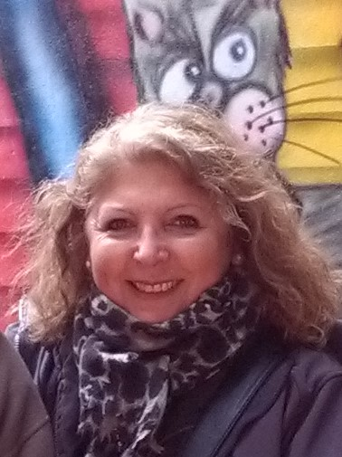
THANKS!

